Slide 1
C++ Basics Review
Templates
Multidimensional Array Index
Pointers

Slide 2
TEMPLATES
From DS and Algorithm by Goodrich

Slide 3
FUNCTION TEMPLATES…GENERIC PROGRAMMING
No need to write the code for so many functions…
Function overloading
template <typename T>
T Maximum(T a, T b)
{
T max = a;
if (a<b)
max = b;
return max;
}
template <class T>
T Maximum(T *a, int size)
{ T max = a[0];
for (int i=0;i<size;++i){
if (a[i] > max)
max = a[i];
}
return max;
}
Both works
void main(){
int m = Maximum(4, 5);
double m1 = Maximum(4.5,7.6);
double darr[] = {52.9, 19.8,10.5};
int iarr[] = {5,7,9,10,3,2,6}
m1 = Maximum(darr,3);
int m2=Maximum(iarr,7)
}
A function template is not an actual function, but instead is a pattern for what could become a function
Notes:
Overloading and Template

Slide 4
CLASS TEMPLATES (Parameterized Ts)
template <class T>
class BasicVector{
public:
BasicVector(int size= 10);
T& operator[ ](int i){ return a[i]; }
bool Add(T element);
bool Del(T element);
// . . . other public members omitted
private:
int maxSize;
int size;
T * array;
};
bool isfull();
template <class T>
BasicVector<T>::BasicVector(int s){
maxSize = s;
}
size = 0;
array = new T[totalCapacity];
Default argument
Operator Overloading
void main(){
BasicVector<int> A1;
BasicVector<float> A2(100);
A1.Add(5);
A2.Add(10.5);
}
Notes:
Based on the parameter T, a class is generated

Slide 5
CLASS TEMPLATES (Parameterized Ts)
template <class T>
bool BasicVector<T>::Add(T element){
{
if (! isFull() ) {
bool b=true;
for (int i = size; i >= 1 && b; i--) {
if (array[i-1] > value)
array[i] = array[i -1];
else
b=false;
}
array[i] = value;
size++;
return true;
}
else
return false;
}
Notes:
Based on the parameter T, a class is generated

Slide 6
CLASS TEMPLATES (Parameterized Ts)
template <class T>
bool BasicVector<T>::Del(T element){
{
bool found=false
if (index < size && index >= 0) {
for (int i = index; i < size - 1; i++)
array[i] = array[i +1];
size--;
found=true
}
return found;
}
Notes:
Based on the parameter T, a class is generated

Slide 7
Exercise: MATRIX WITH TEMPLATES
Implement Matrix class with template
Notes:
We can have any number of parameters we like in the two angular brackets< >

Slide 8
Multimentional Array Addressing Formula
ROW MAJOR CASE

Slide 9
1D Array A[D₀]
Array is stored in a single contiguous memory block.
The starting address of the array is called the base address
It is address of the first element in the array.
Offset (address) of A[i] is calculated as follows:
Offset of A[i] = base_address + i * size_of_element
Array is a very efficient. We can access any array element in O(1) time.
₀ | ₁ | ₂ | … | _{i} | … | _{n-1}

Slide 10
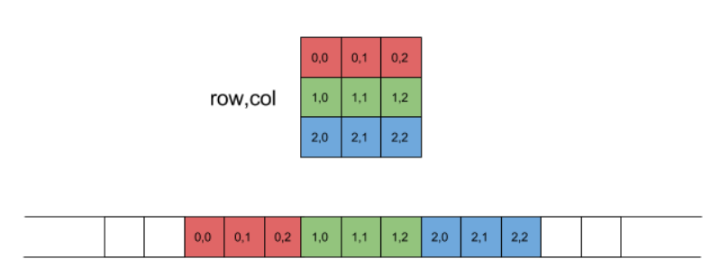
2D Array A[D₀][D₁]
User’s view (abstraction)
ROW MAJOR
System’s view (implementation)
Offset of A[i][j]?
https://eli.thegreenplace.net/2015/memory-layout-of-multi-dimensional-arrays

Slide 11
2D Array A[D₀][D₁]
Offset of A[i][j]?
Number of elements in each row?
i^{th} row
total elements in the previous rows?
j^{th} element in i^{th} row
D₁
i * D₁
i * D₁+ j
Offset of A[i][j] = base_address+ (i * D₁+ j)*size_of_element
https://eli.thegreenplace.net/2015/memory-layout-of-multi-dimensional-arrays

Slide 12
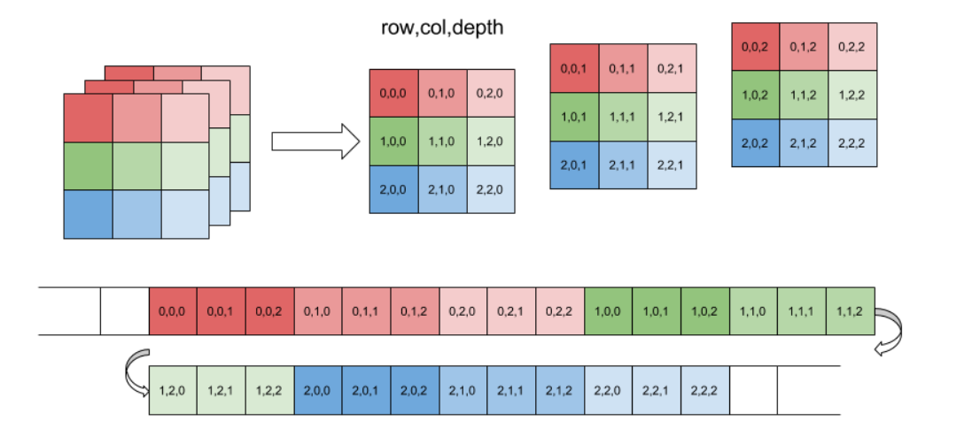
3D Array A[D₀][D₁][D₂]
Offset of A[i][j][k] = i*D₁*D₂ + j*D₂ + k
https://eli.thegreenplace.net/2015/memory-layout-of-multi-dimensional-arrays

Slide 13
ND Array A[D₀][D₁]…[D_{n-1}]
Offset of A[d₀][d₁][d₂] = d₀ *D₁*D₂ *…*D_{n-1} +
d₁ *D₂ *…*D_{n-1} +
… +
d_{n-2}*D_{n-1} +
d_{n-1}

Slide 14
Exercise: Find Formula for Column Major Form
Notes:
We can have any number of parameters we like in the two angular brackets< >

Slide 15
Pointers
From:
“Data structures and algorithms” by Adam Drozdek,

Slide 16
Pointers
Points to a memory location
The content of a pointer is a memory address of a variable
Allow us to access value of other variables indirectly
A
int A = 10;
int * P ;
P = &A;
P
10
0x1548
0x1548
0x3478
TO DO
Always initialize a pointer to NULL
int *x;
x = 0;
x = NULL;
x = nullptr;
What’s the difference?
P = &A;
& is address operator and stores reference to x
cout << *P ;
* is the de-reference operator
Notes:
enough bytes to represent all possible memory addresses
all 3 statements of NULL ptr enough bytes to represent all possible memory addressesare equivalent

Slide 17
Some Facts about Pointers
Pointers Types
Pointers are of the same size. WHY ?
But it is inappropriate to assign an address of one type of variable to a different type of pointer
integerPtr
integer
7
realPtr
real
10.0
Notes:
enough bytes to represent all possible memory addresses
all 3 statements of NULL ptr enough bytes to represent all possible memory addressesare equivalent

Slide 18
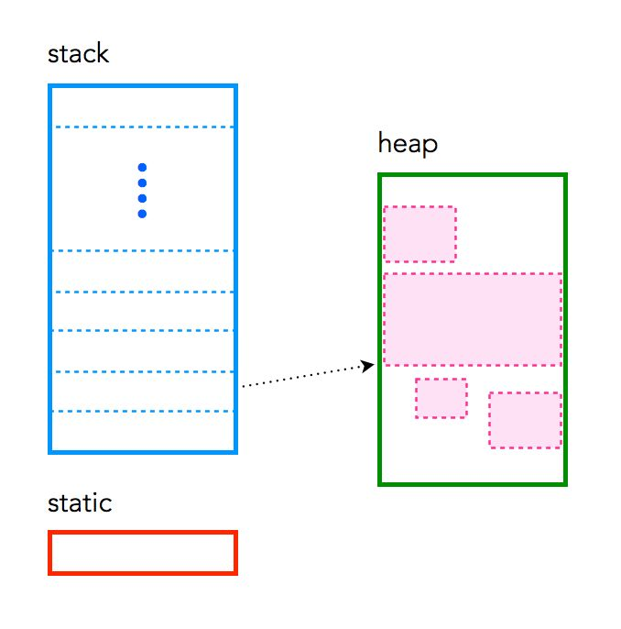
Memory Allocation
{
int a[200];
…
}
int* ptr;
ptr = new int[200];
…
delete [] ptr;
https://craftofcoding.wordpress.com/2015/12/07/memory-in-c-the-stack-the-heap-and-static

Slide 19
Why Pointers?
Pointers allow programmers to refer and use the same chunk of memory again and again.
Eliminate the need of creating copies of data
Used in dynamic memory allocation (especially of arrays)
Essential for building advance data structures like linked lists and binary trees, etc.
Notes:
Dynamic memory allocation is done on heap

Slide 20

Major issues with Pointers

Slide 21
Dangling Pointer Problem
int *A = new int[5];
for(int i=0; i<5; i++)
A[i] = i;
int *B = A;
delete [] A;
B[0] = 1; // illegal!

Slide 22
Memory Leak
int *A = new int [5];
for(int i=0; i<5; i++)
A[i] = i;
A = new int [5];
1
2
3
A
0
2
4

Slide 23
Yet Anothor MEMORY LEAK
x
y
int *x = NULL,*y = NULL;
x = new int;
y = new int;
*x = 10;
*y = 15;
y = x;
x
p
x
y
10
15
x
y
10
Memory leak
This memory can no longer be accessed

Slide 24
Memory Leak & Dandling Pointer
x
p
int *x = NULL,*p = NULL;
x = new int;
p = new int;
*x = 10;
*p = 12;
p = x;
delete p
*x = 15 (this will cause system to crash)
Why??
Identify Memory Leak.
x
p
x
p
10
12
x
p
10
x
p
10

Slide 25
Pointers & Functions
void inc(int *p){
*p = *p +1
}
void main(){
int x=20;
Inc(&x);
}
Inc p
main x
20
Using reference
void inc(int &r){
r=r+1
}
void main(){
int x=20;
inc(&x);
}

Slide 26
Whats wrong?
Identify the issues in the code
void Dummy(int *p)
{
p = new int;
*p = 10;
}
void main()
{
int *x = 0;
Dummy(x);
*x = 1;
}

Slide 27
Solution ?
Will this work?
void Dummy(int **p){
*p = new int;
**p = 10;
}
void main(){
int *x = 0;
Dummy(&x);
}
Dummy p
main x
10

Slide 28
Whats Wrong ?
int * input(){
int a=0;
cin>>a;
return &a;
}
void main(){
int * val = input();
cout<<val ?
}
What will be the output ?
Will program crash?
Why?
Is val a dangling pointer?
Notes:
Dangling pointers are pointers that do not point to valid objects in memory like this one

Slide 29
Solution ?
void input(int * &ptr){
ptr =new int;
cin>>*ptr;
}
void main(){
int * val = nullptr;
input(val);
cout<<val
}
Will this Work ?

Slide 30
Pointers to Pointers
A pointer can also be made to point to a pointer variable (but the pointer must be of a type that allows it to point to a pointer)
int x = 101;
int *p = &x;
int **q = &p;
cout<<x<<“ “<<*p<<“ “<<**q;
Output?
Notes:
/* prints 101 3 times */

Slide 31
Pointers & Arrays
Name of the array is a pointer. It points to the first item of the array.
char arr[10];
char *arrptr;
char *ptr;
arrptr = arr;
ptr = &arr[0];
0 1 2 3 4 5 6 7 8 9
arr
arrptr
ptr

Slide 32
1D ARRAY
void input(int *p, int Size) {
for (int i = 0; i < Size; i++)
p[i] = i;
}
void alloc(int* &p, int size) {
p = new int[10];
}
void dealloc(int*&p) {
delete[] p;
}
To change the elements of the array simply pass pointer array
To change the value of pointer pass the address of the pointer
0 | 1 | 2 | 3 | 4 | 5 | 6 | 7 | 8 | 9
Input a
void main() {
int * arr = nullptr;
alloc(arr, 5);
input(arr, 5);
dealloc(arr);
}
Alloc arr
main array
Notes:
Same
void Alloc(int * *arr, int Size)
{
*arr = new int[Size];
}

Slide 33
2D ARRAY
void input2d(int **p, int r, int c) {
for (int i = 0; i < r; i++)
for (int j = 0; j < c; j++)
p[i][j] = i;
}
void alloc2d(int** &p, int r, int c) {
p = new int*[r];
for (int i = 0; i < r; i++)
p[i] = new int[c];
}
void dealloc2d(int** &p,int r) {
for (int i = 0; i < r; i++)
delete [] p[i];
delete[] p;
}
darr[0] darr[1] darr[2]
input2d darr
int* | int* | int*
void main() {
int ** darr = nullptr;
int r = 5, c = 2;
alloc2d(darr, r, c);
input2d(darr, r, c);
dealloc2d(darr,r);
}
Alloc2d
Notes:
Same
void Alloc(int * *arr, int Size)
{
*arr = new int[Size];
}

Slide 34


POINTERS TO OBJECTS
class Employee
{
public:
Employee();
~Employee();
void Enroll();
float GetGPA();
void ComputeGPA();
private:
float GPA;
char *Name;
};
Whats missing???
void functionA()
{
Employee *Sptr = new Employee;
Sptr->Enroll();
cout << S->GetGPA();
}
void functionA()
{
Employee S;
S.Enroll();
cout << S.GetGPA();
}
Make a note of where we use dot notation and where we use arrows

Slide 35
DEEP Vs. SHALLOW COPY
int *p, *q;
p = new int;
*p = 5;
q = p;
int *p, *q;
p = new int;
q = new int;
*p = 5
*q = *p;
Vs.
DRAW THE PICTURES TO UNDERSTAND

Slide 36
DEEP COPY Vs SHALLOW COPY
class Employee
{
public:
Employee(){ID=-1; Name=NULL;};
~Employee();
void CopyEmp(Employee & S);
void SetName(char *N);
private:
float GPA;
char *Name;
};
void Employee::CopyEmp(Employee &S1)
{
S1.GPA = GPA;
S1.Name = Name;
}
Which CopyEmp function is better ?
void Employee::CopyEmp(Employee &S1)
{
S1.GPA = GPA;
S1.Name =new char(strlen(Name)+1);
strcpy(S1.Name, Name);
}
void main()
{
Employee A, S;
A.SetName(“Amna”);
A.CopyEmp(S);
}
void Employee::SetName(char * n)
{
S1.Name = n;
}
Whats wrong with SetName ?

